Slide 1
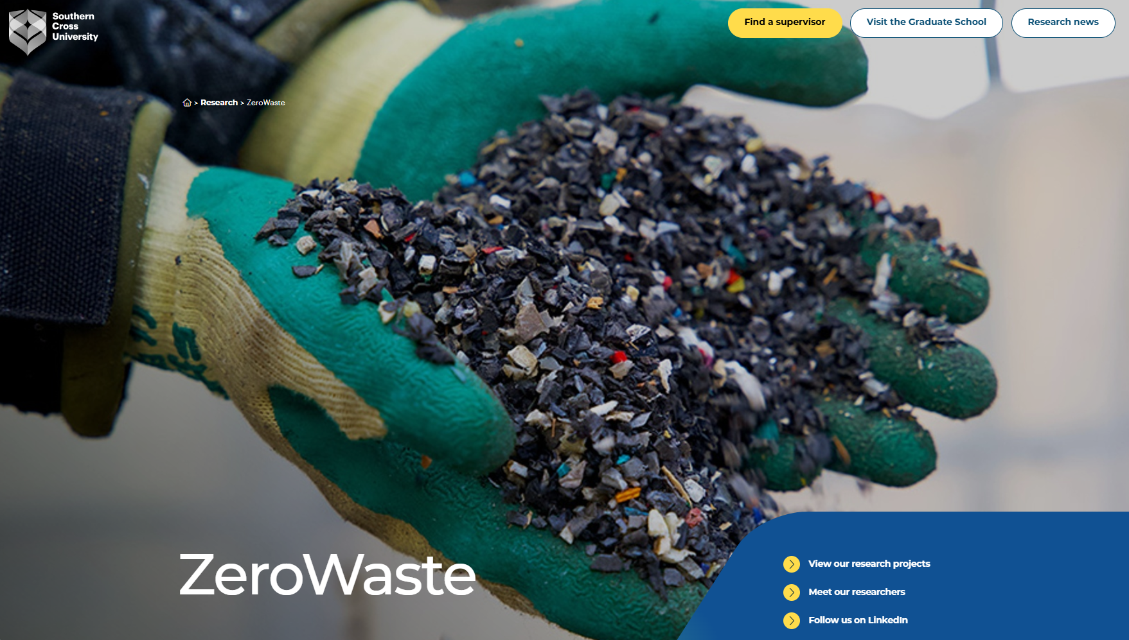


Slide 2
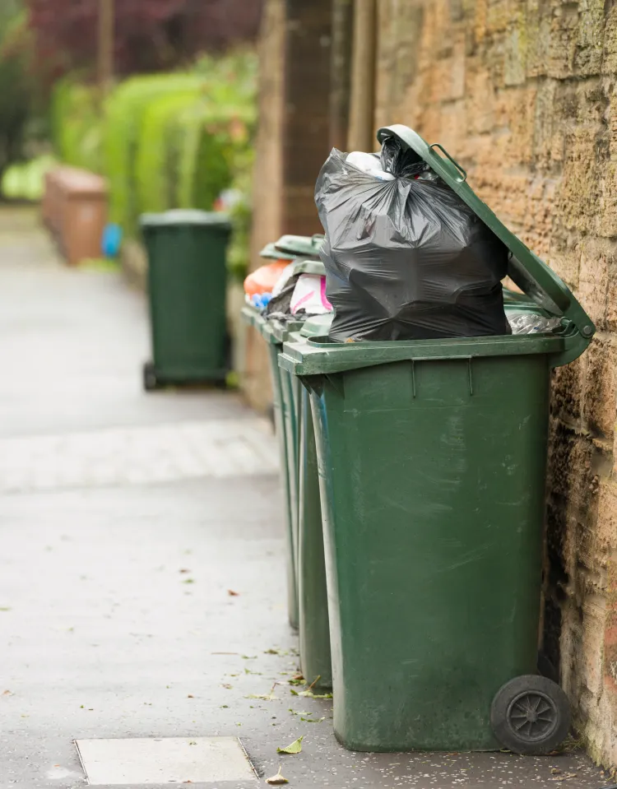
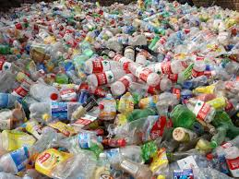
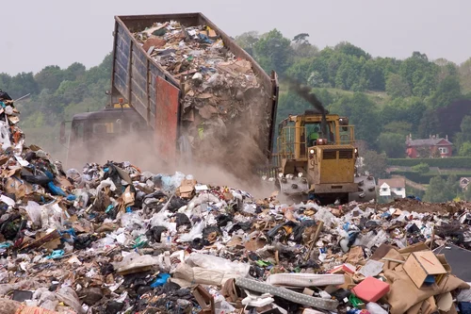
Why Does Waste Matter?
540
Australia produces:
kg waste/person/year
Plastic can last hundreds of years!
Most waste still goes to landfill

Slide 3
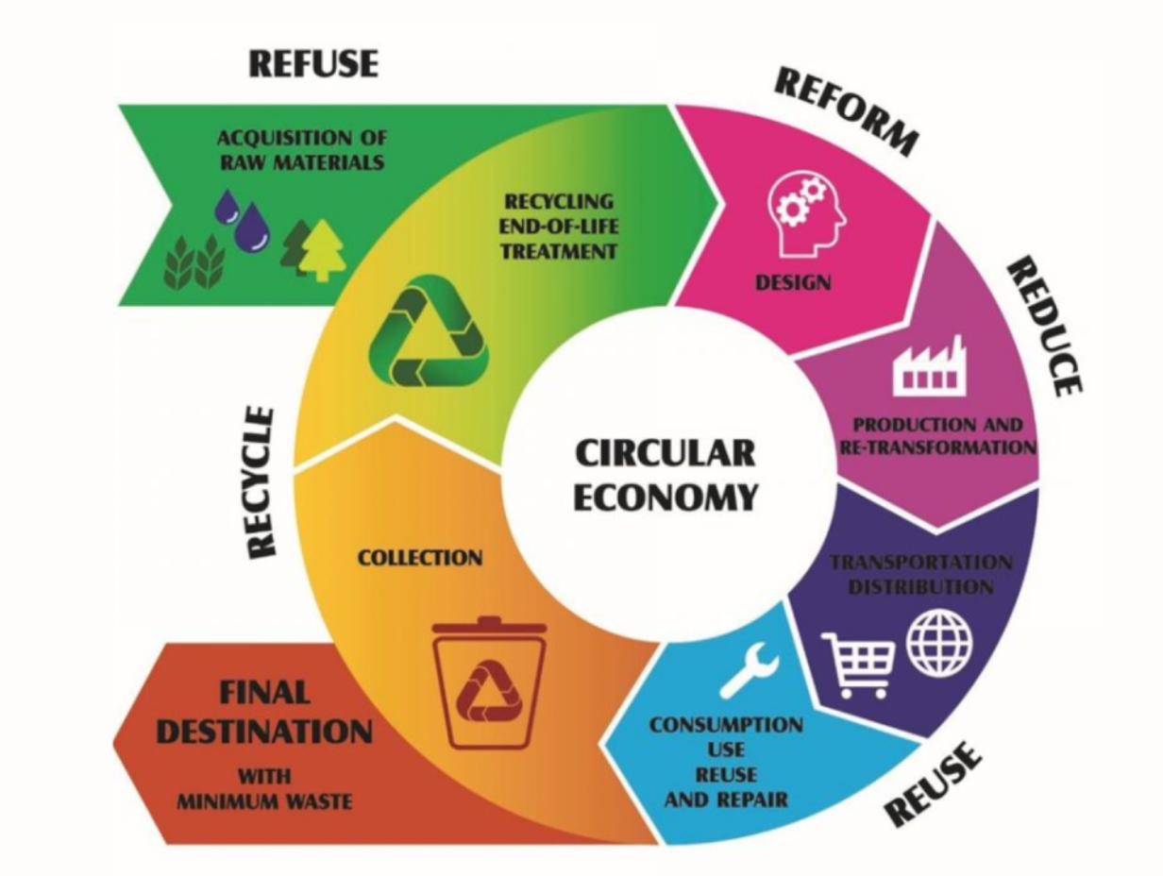
Rethink, Reuse, Recycle!
Less waste, more reuse!
Zero-Waste: sending nothing to landfill!

Slide 4
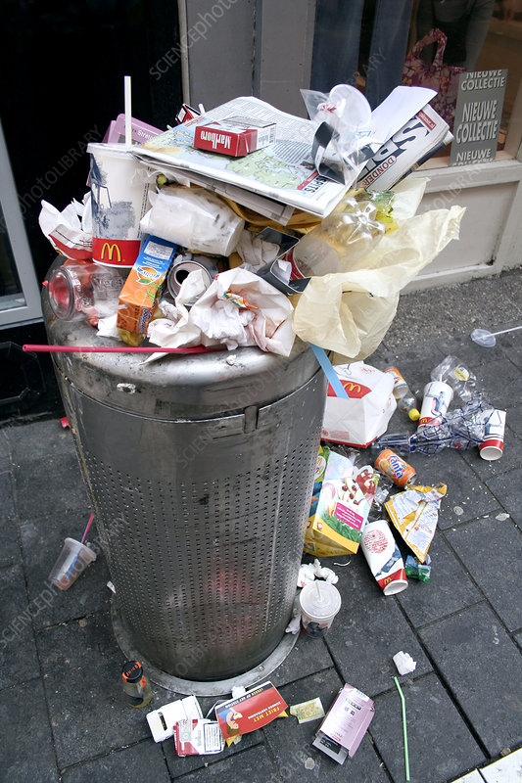
What do you do when you finish a drink or snack?

Slide 5
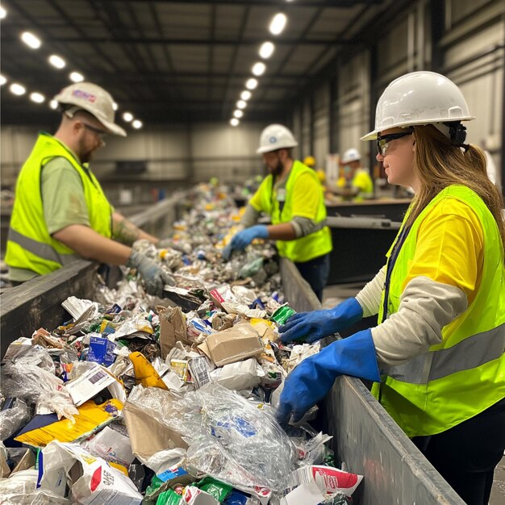
Why Sorting Waste is Hard?

Slide 6
Waste and recycling colour coding
Australian Standards – waste and recycling colour coding (AS4123.7-2006)

Slide 7
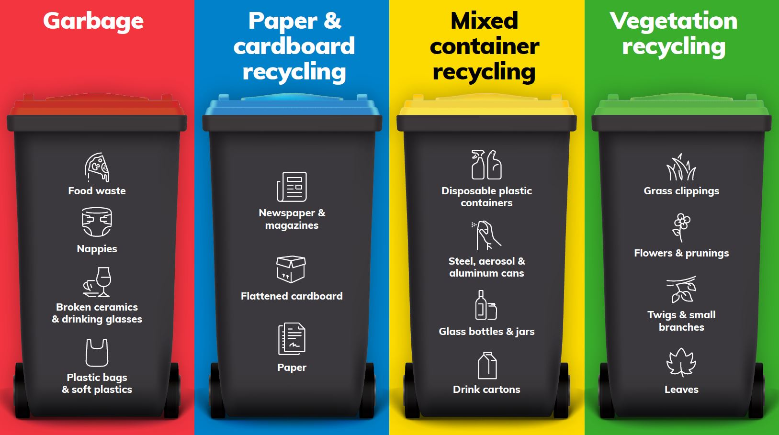

Slide 8
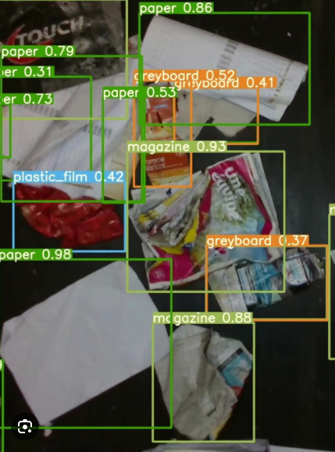
How Can AI Help?

Slide 9
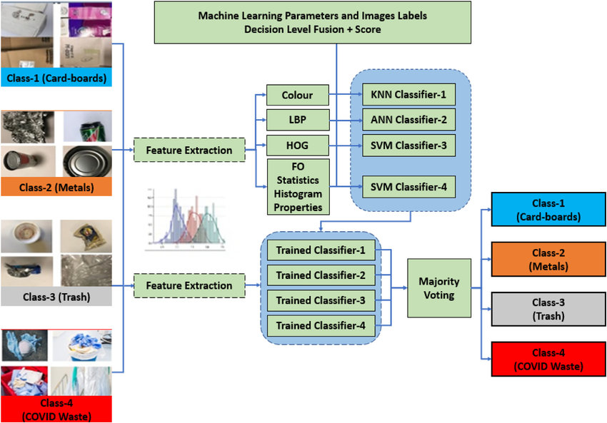
How does AI work?

Slide 10
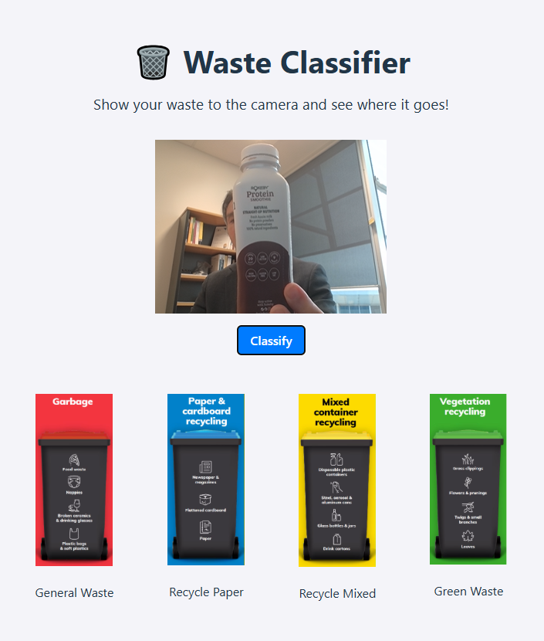
What are we building today?

Slide 11
STEP 1
npm create vite@latest waste-classifier --template react
cd waste-classifier
npm install
npm install @tensorflow/tfjs react-webcam framer-motion
npm install @teachablemachine/image
STEP 2
waste-classifier/
public/
model/
images
recycle_paper.png
recycle_mixed.png
green_waste.png
general_waste.png
src/
components/
WebcamCapture.jsx
WasteDisplay.jsx
App.jsx
App.css
main.jsx
Your instructors will provide the codes so you can copy.

Slide 12
STEP 3
Train the classification model with the teachable machine
You will work in group to train a model to do waste classification.
STEP 4
Download the trained model to model folder
waste-classifier/
public/
model/
model.json
metadata.json
weights.bin
images
recycle_paper.png
recycle_mixed.png
green_waste.png
general_waste.png
src/
components/
WebcamCapture.jsx
WasteDisplay.jsx
App.jsx
App.css
main.jsx

Slide 13
Run and test your product
npm dev run
And follow instruction on the screen

Slide 14
Refection
Does your classifier work?
Does it make error? Why?
What is the most interesting thing you have learnt today?

